Slide 1
How to best use these slides…
View the PPT as a slide show
Then click through every step
Mouse clicks will advance the slide show
Left/right arrow keys move forward/backward
Mouse wheel scrolling moves forward/backward
When a question is posed, stop and think it through, try to answer it yourself before clicking
If you have questions, use PS discussion boards, email me, and/or visit us in a Teams class session!

Slide 2
LESSON 7.1b
Writing Inverse Variation Equations & Modeling

Slide 3
Today you will:
Write inverse variation equations
Practice using English to describe math processes and equations

Slide 4
Core Vocabulary:
Inverse variation, p. 360
Constant of variation, p 360
Previous:
Direct variation
Ratios

Slide 5
Suppose we are told:
The variables $x$ and $y$ vary inversely
When $x=4$, then $y=8$
…and we were asked to come up with the equation for the inverse variation relationship…
How would we do this?
Well, again … let’s ask ourselves some questions:
What information are we given?
That it is an inverse relationship → $y=\frac{a}{x}$
…and we know 1 set of values for $x$ and $y$
What information are we missing?
We don’t know the constant of variation $a$
If we knew $a$ we could write the equation!
Okay, so let’s find $a$!
Write the general equation out, and fill in what we know
Solve for what we don’t know!
Solution:
general equation: $y=\frac{a}{x}$
fill in what we know: $x=4, y=8$
$$8=\frac{a}{4}$$
solve for what we don’t know:
$$a=32$$
use this value of $a$ to write the equation:
$$y=\frac{32}{x}$$
✓

Slide 6
The variables x and y vary inversely, and y $=$ 4 when x $=$ 3. Write an equation that relates x and y. Then find y when x $=$ $−$2.
Because x and y vary
inversely, you also know
that the products xy are
constant. This product
equals the constant of
variation a. So, you can
quickly determine that
a $=$ xy $=$ 3(4) $=$ 12.
SOLUTION
y $=$ $\frac{\text{a}}{\text{x}}$
Write general equation for inverse variation.
4 $=$ $\frac{\text{a}}{\text{3}}$
Substitute 4 for y and 3 for x.
12 $=$ a
Multiply each side by 3.
The inverse variation equation is y $=$ $\frac{\text{12}}{\text{x}}$. When x $=$ $−$2, y $=$ $\frac{\text{12}}{−\text{2}}$ $=$ $−$6.

Slide 7
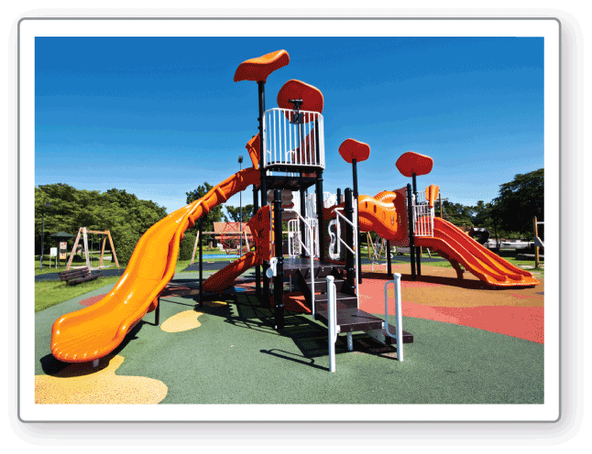
The time t (in hours) that it takes a group of volunteers to build a playground varies inversely with the number n of volunteers. It takes a group of 10 volunteers 8 hours to build the playground.
Now let’s put all this to work and use it to solve a real-world problem!
Make a table showing the time that it would take to build the playground when the number of volunteers is 15, 20, 25, and 30.
What happens to the time it takes to build the playground as the number of volunteers increases?
SOLUTION
1. Understand the Problem You are given a description of two quantities that vary inversely and one pair of data values. You are asked to create a table that gives additional data pairs.
2. Make a Plan Use the time that it takes 10 volunteers to build the playground to find the constant of variation. Then write an inverse variation equation and substitute for the different numbers of volunteers to find the corresponding times.

Slide 8

2. Make a Plan Use the time that it takes 10 volunteers to build the playground to find the constant of variation. Then write an inverse variation equation and substitute for the different numbers of volunteers to find the corresponding times.
Notice that as the number
of volunteers increases by
5, the time decreases by a lesser and lesser amount.
From n $=$ 15 to n $=$ 20, t decreases by 1 hour 20 minutes.
From n $=$ 20 to n $=$ 25, t decreases by 48 minutes.
From n $=$ 25 to n $=$ 30, t decreases by 32 minutes.
3. Solve the Problem
t $=$ $\frac{\text{a}}{\text{n}}$
Write general equation for inverse variation.
8 $=$ $\frac{\text{a}}{\text{10}}$
Substitute 8 for t and 10 for n.
80 $=$ a
Multiply each side by 10.
The inverse variation equation is t $=$ $\frac{\text{80}}{\text{n}}$. Make a table of values.
n | 15 | 20 | 25 | 30
t | $\frac{\text{80}}{\text{15}}$ $=$ 5 h 20 min | $\frac{\text{80}}{\text{20}}$ $=$ 4 h | $\frac{\text{80}}{\text{25}}$ $=$ 3 h 12 min | $\frac{\text{80}}{\text{30}}$ $=$ 2 h 40 min
As the number of volunteers increases, the time it takes to build the playground decreases.
4. Look Back Because the time decreases as the number of volunteers increases, the time for 5 volunteers to build the playground should be greater than 8 hours.
✓
t $=$ $\frac{\text{80}}{\text{5}}$ $=$ 16 hours

Slide 9
Review/recap
You can come up with the equation for an inverse variation if you are given 1 set of $x \& y$ values:
Write the general inverse variation equation
Fill in what you know ($x \& y$)
Solve for what you don’t know ($a$)
Write the final equation using the value for $a$ from step 3
To solve real-world problems:
You will be told if the data varies directly or inversely
You will be given some of the data
Use that data to find $a$, and write the resulting equation
If asked to describe a trend or “end behavior”, build a table of values to see what is going on
Some good Khan Academy videos:
Direct variation word problem: filling gas
Direct variation word problem: space travel
Inverse variation word problem: string vibration

Slide 10
Homework
Pg 363, #15-30

